Slide 1

ANALYSIS OF AUTISM SPECTRUM DISORDER DETECTION TECHNIQUES
K. Santhosh kumar
Dept of IT
22L31F0021
Under the Guidance of
K. Venkatesh Babu
Asst /Assoc/Prof
Dept of IT

Slide 2
CONTENTS
Abstract
Introduction
Existing System
Proposed System
Literature Survey
Methodology(algorithm)
System Design(architecture Diagram + UML Diagrams)
Results
Test Cases
Conclusion

Slide 3
ABSTRACT
Autism Spectrum Disorder (ASD) is a neurodevelopment disorder accompanied by sensory issues such as over-sensitivity or under-sensitivity to sounds, smells, or touch. Present-day Autism Spectrum Disorder (ASD) is gaining momentum faster than ever. Detecting autism traits through screening tests is very expensive and time-consuming. With the advancement of Machine Learning, autism can be predicted at quite an early stage. The main aim of this project is to analyze various Machine learning algorithms, used by various researchers like SVM (Support Vector Machine), Random Forest, Decision Trees, and Logistic Regression, Naïve bayes and compare the result based on their accuracy and efficiency.

Slide 4
INTRODUCTION
Autism spectrum disorder (ASD) is a developmental disability caused by differences in the brain. Some people with ASD have a known difference, such as a genetic condition. Other causes are not yet known. Scientists believe there are multiple causes of ASD that act together to change the most common ways people develop.
People with ASD may behave, communicate, interact, and learn in ways that are different from most other people. There is often nothing about how they look that sets them apart from other people. The abilities of people with ASD can vary significantly.
For example, some people with ASD may have advanced conversation skills whereas others may be nonverbal. Some people with ASD need a lot of help in their daily lives; others can work and live with little to no support.
ASD begins before the age of 3 years and can last throughout a person’s life, although symptoms may improve over time. Some children show ASD symptoms within the first 12 months of life.

Slide 5
EXISTING SYSTEM
The existing systems use older machine learning algorithms like logistic regression, Decision Tree. Which are efficient in processing but fails to generate good accuracy. There are some systems which use Deep learning for autism detection but they require high processing power and are a bit complex to use.
Low accuracy
High complexity
Difficult to scales

Slide 6
PROPOSED SYSTEM
With the advancement of machine learning (ML), autism can be predicted at quite an early stage. The main aim of this project is to analyze various Machine learning algorithms, used by various researchers like SVM (Support Vector Machine), Random Forest, Decision Trees, Logistic Regression, and compare the result based on their accuracy and efficiency.
High accuracy
Low complexity
Easy to scale

Slide 7
LITERATURE SURVEY
Early Detection of Autism Spectrum Disorder: A Machine Learning Approach: This study explores the use of machine learning algorithms for early detection of ASD using behavioral and genetic data. Various features such as eye contact, social interaction patterns, and genetic markers are used to train the model.
Predicting Autism Spectrum Disorder Using Machine Learning Techniques: This paper investigates the prediction of ASD using machine learning techniques on neuroimaging data, such as MRI and fMRI scans. Features extracted from brain imaging data are fed into the model to classify individuals as ASD or neurotypical.
Machine Learning for Autism Diagnosis and Prognosis: This review article provides an overview of recent advancements in using machine learning for ASD diagnosis and prognosis.

Slide 8
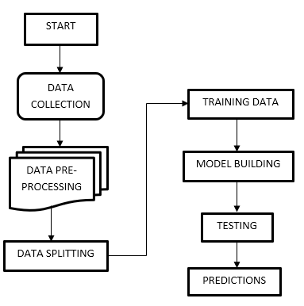
SYSTEM DESIGN

Slide 9
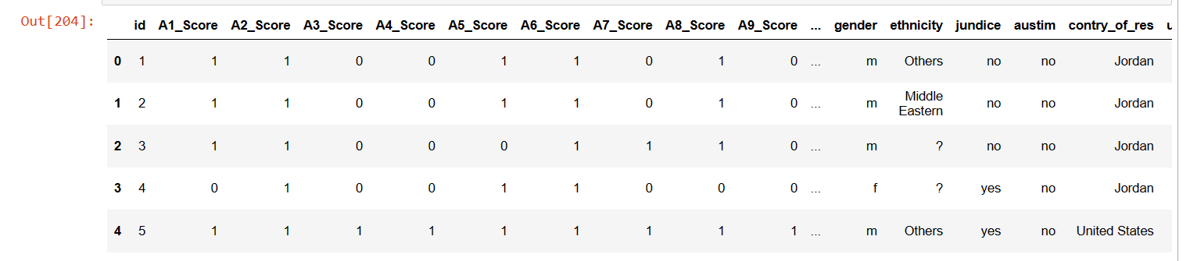
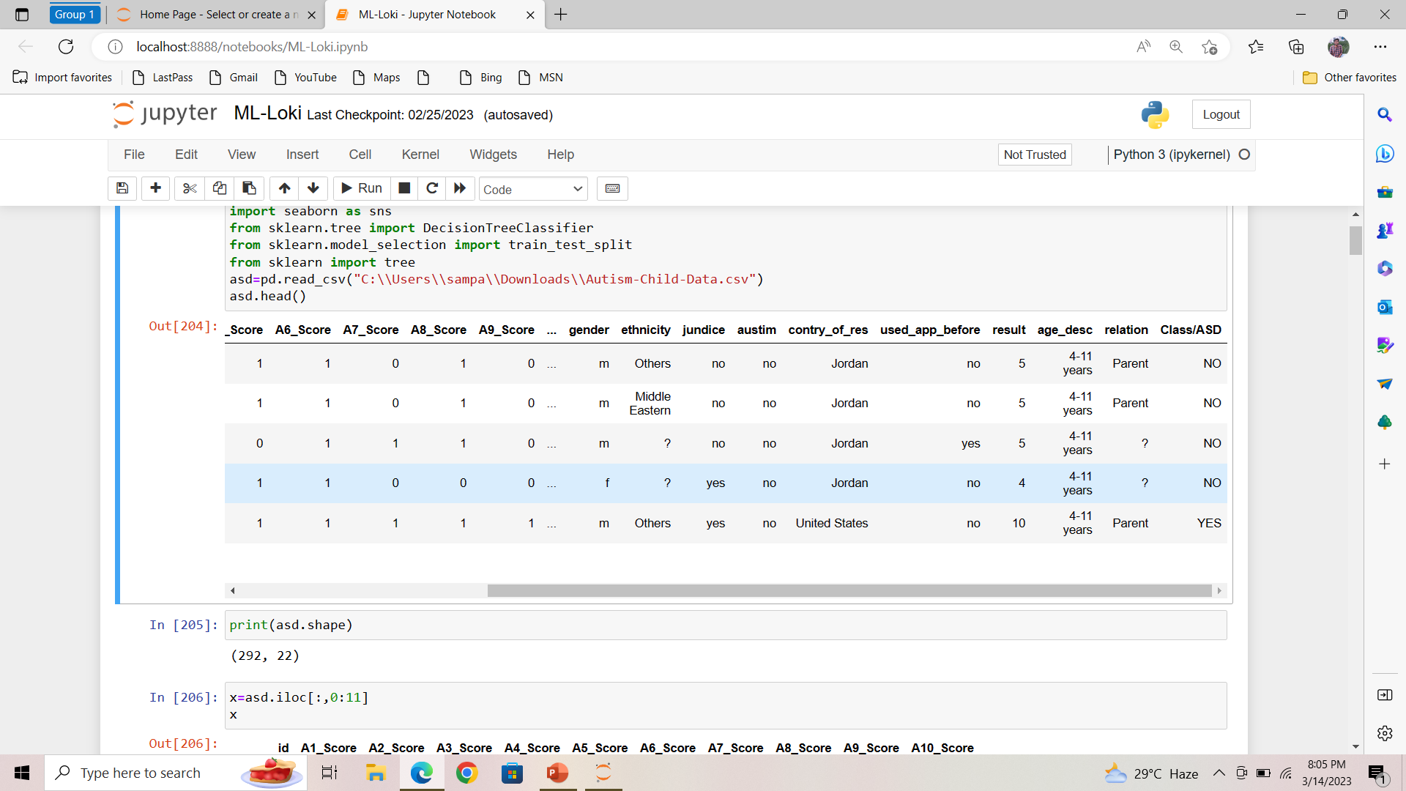
DATASET

Slide 10
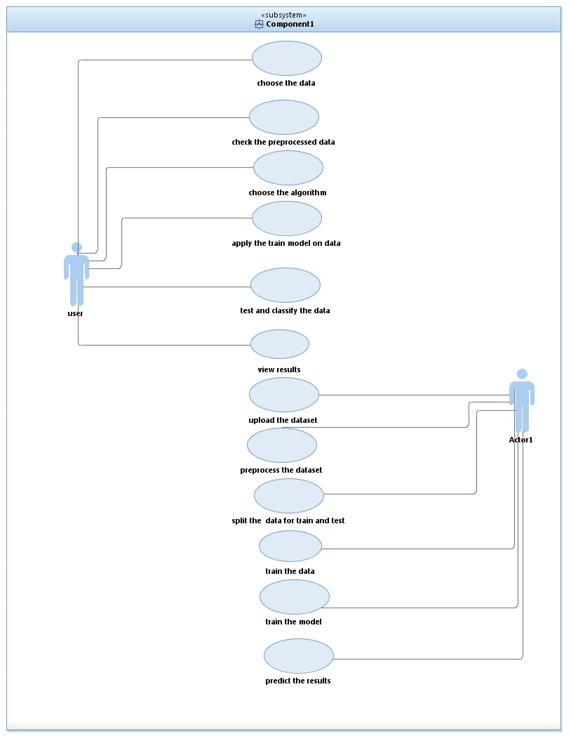
UML DIAGRAMS
Use case Diagram:

Slide 11
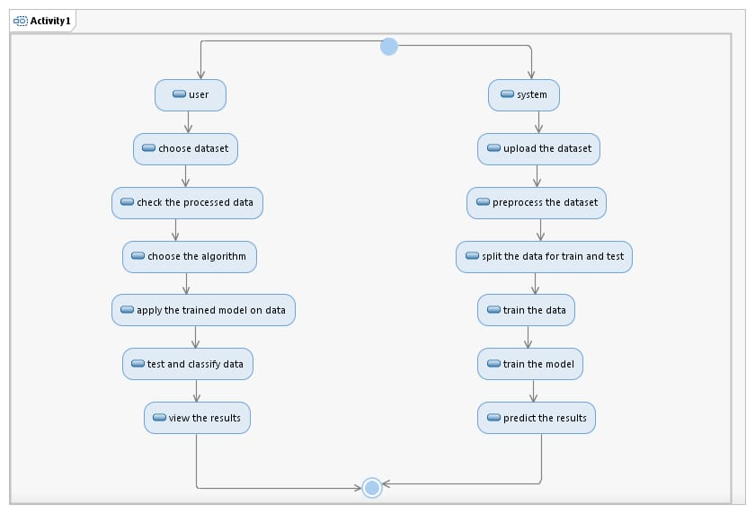
ACTIVITY DIAGRAM
Activity Diagram:

Slide 12
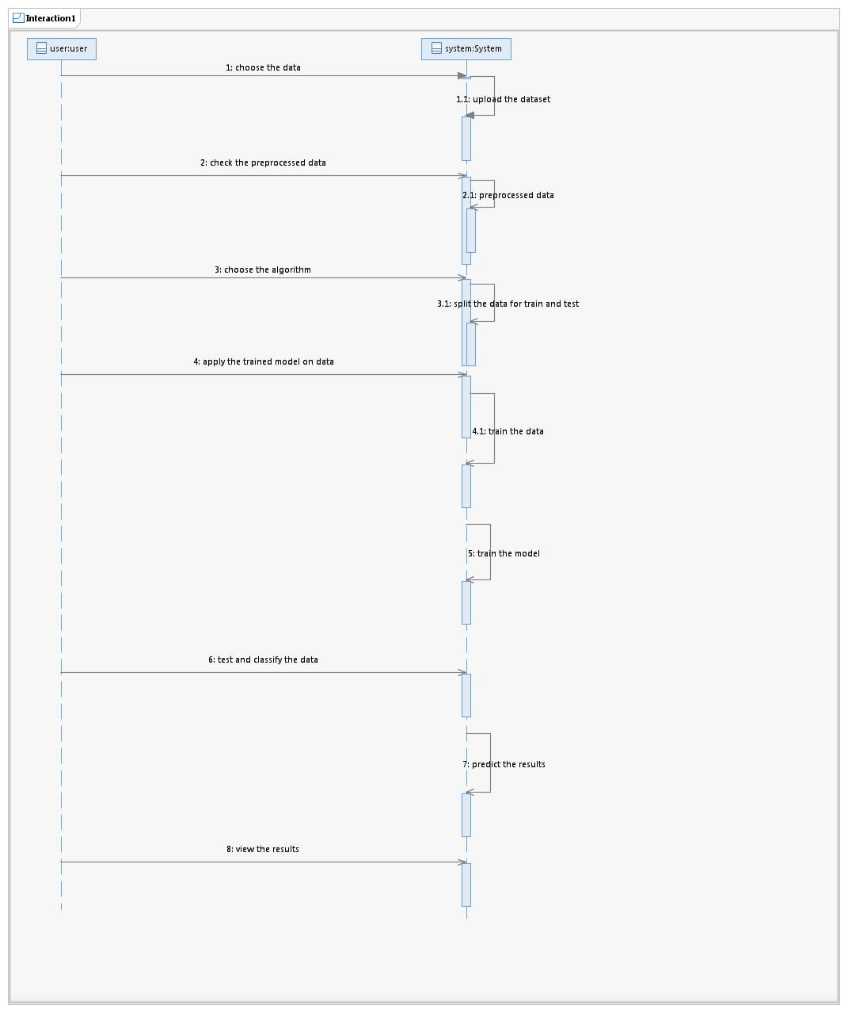
SEQUENCE DIAGRAM
Sequence Diagram:

Slide 13
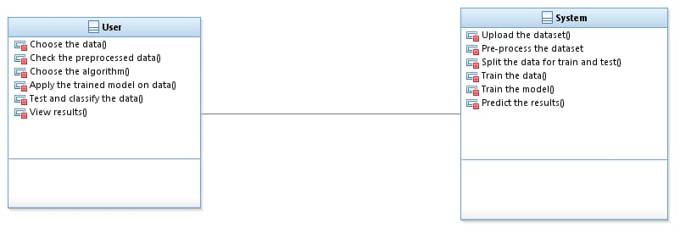
CLASS DIAGRAM

Slide 14
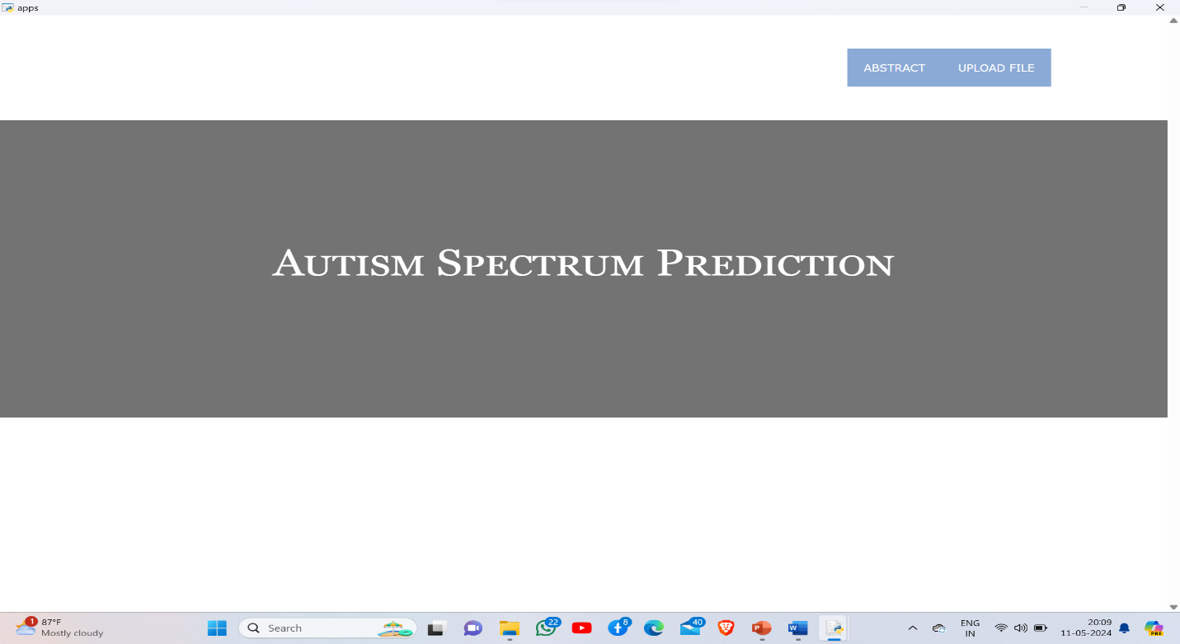
RESULTS
Home page:

Slide 15
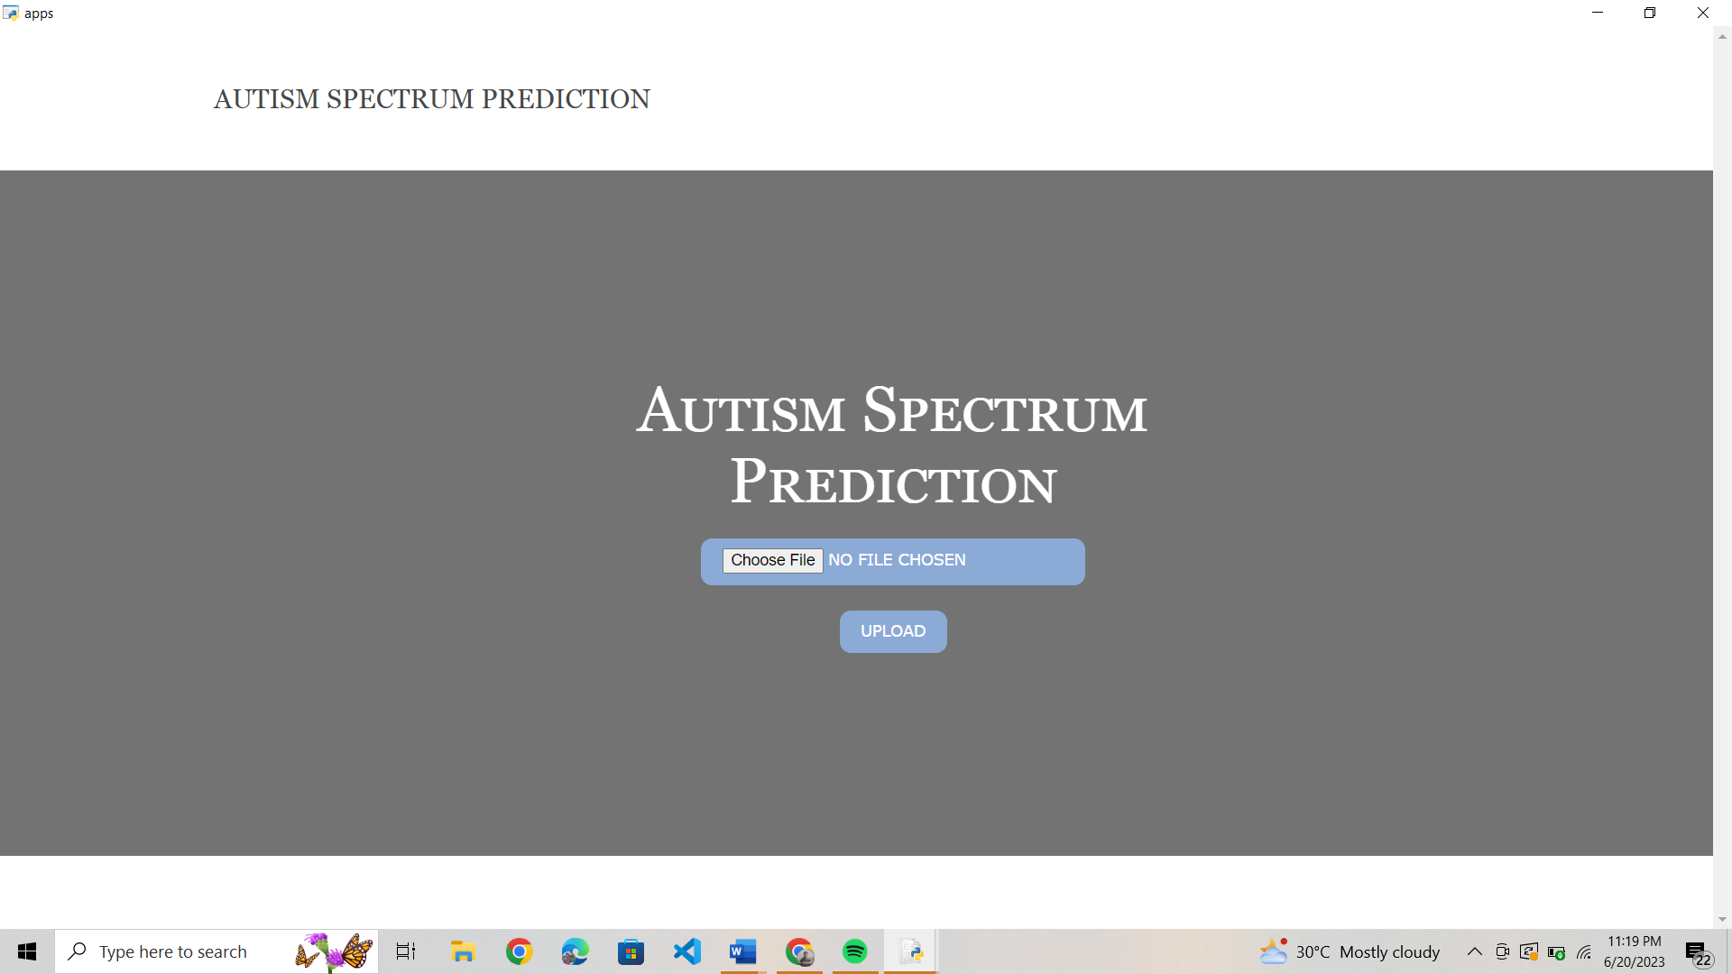
Dataset page:

Slide 16
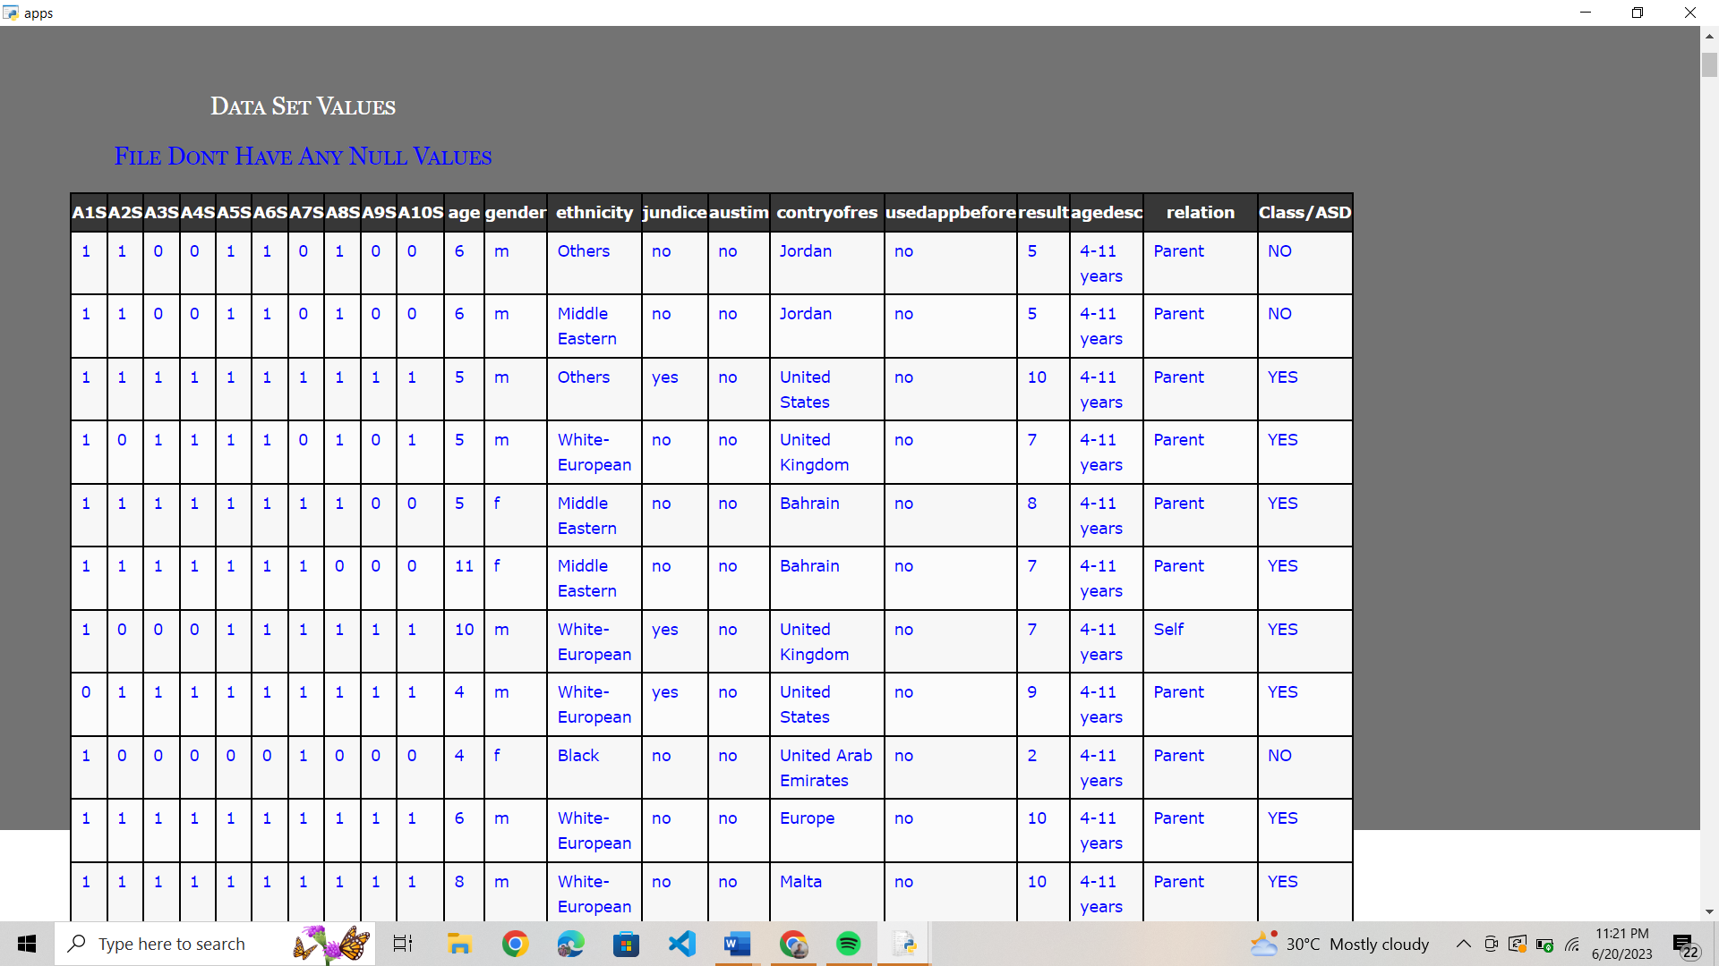
Dataset page:

Slide 17
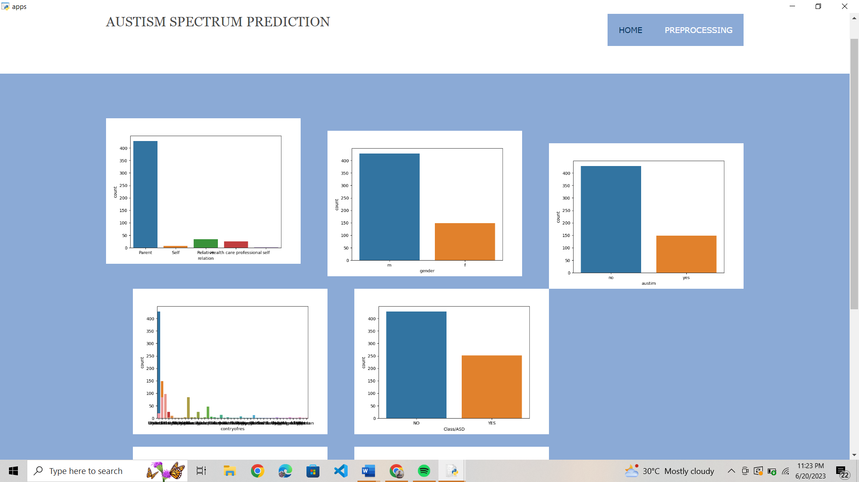
Graph Page:

Slide 18
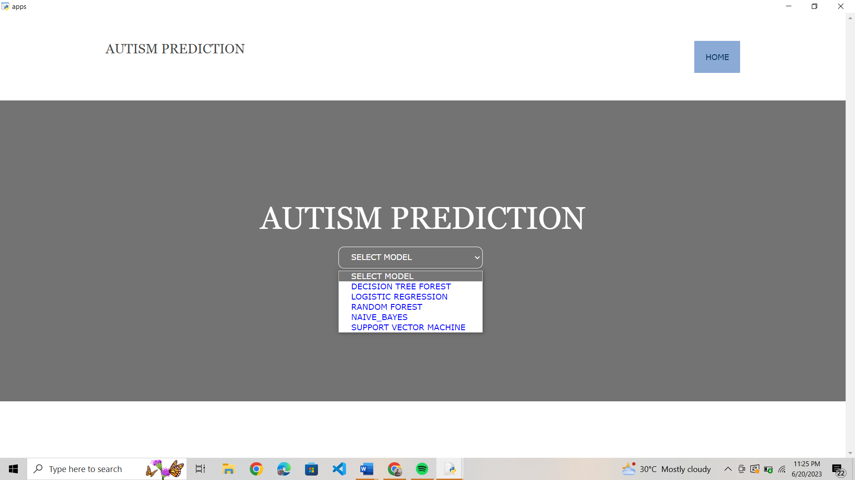
Model Selection Page:

Slide 19
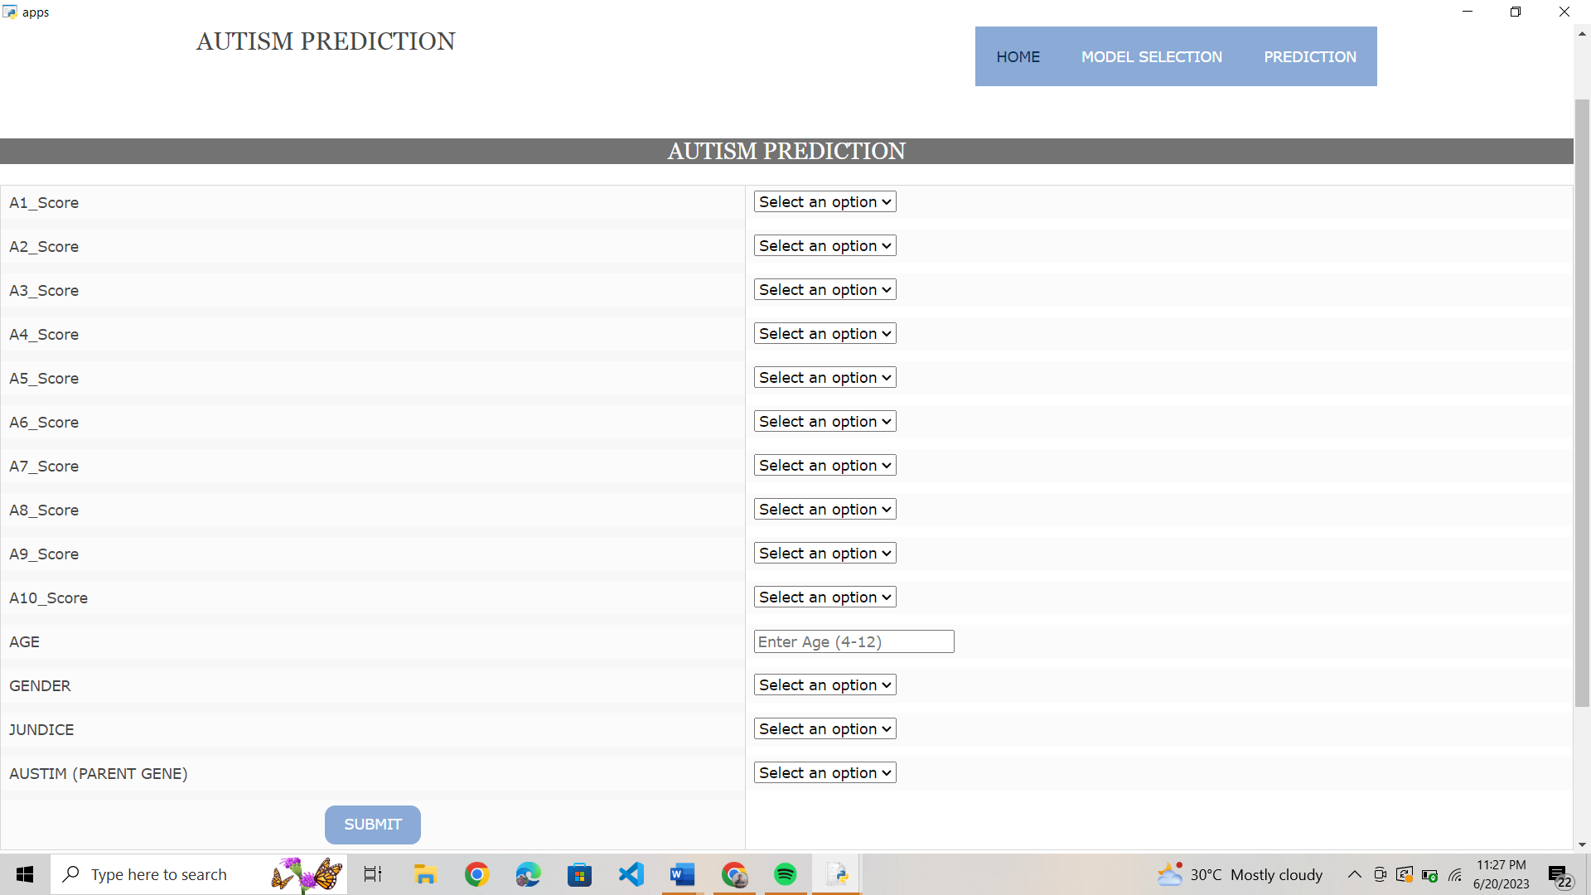
Prediction Page

Slide 20
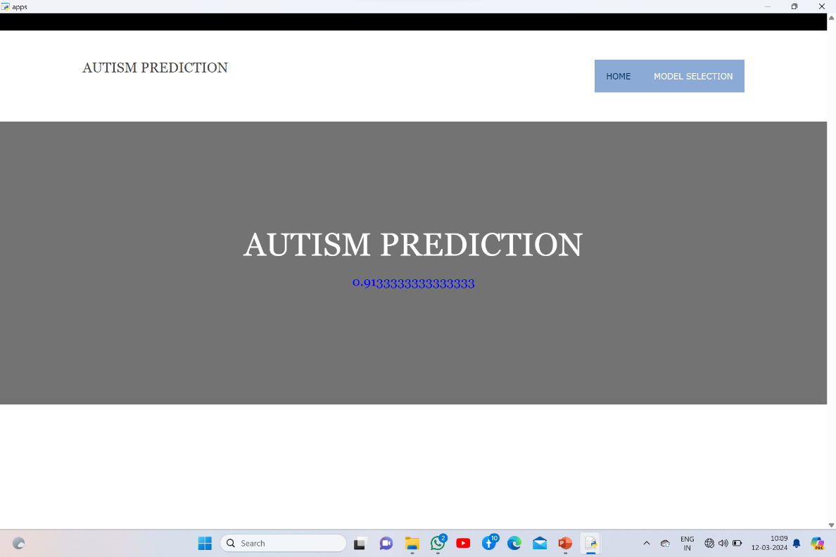
Output:

Slide 21
TEST CASES

Slide 22
CONCLUSION
Autism is one of the vital issues which cannot be prevented but can be treated and it’s a big challenge for any family to have a child with autistic disorder. Therefore, it’s importance to diagnose it, as early as possible. One of the major issues in today’s research is to have improved diagnostic tools to have faster, effective and accurate result. Machine learning techniques have shown favorable results. Machine learning with its leverage methods can be used to diagnose ASD. Use of machine Learning are to create algorithms that are vigorous and have contrive instruments. By using different ML algorithms researchers were able to build such model which shows improved results in terms of accuracy and precisions. In this analysis various classifiers have been used like SVM, Random Forest, decision tree, LMT, KNN, Naïve Bayes’, LDA and so on. Among all SVM have shown the best result with an accuracy of 98.27%.

Slide 23
REFERENCES
[1] U. Frith and F. Happé, “autism spectrum disorder,” Current biology, vol. 15, no. 19, pp. R786–R790, 2005
[2] Dr. Archana Nayar, “http://www.csrmandate.org/autism-centre-forexcellence-unlocking-unlimited-potentials-for-autistic-children”, 2017.
[3] Paul Fergus, Basma Abdulrahman, Chris Carter, Sheena Round, “Interactive Mobile Technology for Children with Autism Spectrum Condition (ASC)”, “IEEE 11th Consumer Communications and Networking Conference (CCNC)”, 10.1109/CCNC.2014.7111685, 2014.
[4] Wando Liu, Ming Li, and Li Yi, " Identifying Children with Autism Spectrum Disorder Based on Their Face Processing Abnormality: A Machine Learning Framework”, International Society for Autism Research, Wiley Periodicals,2016
[5] Kayleigh K. Hyde, Marlena N. Novack, Nicholas LaHaye, Chelsea Parlett-Pelleriti,Raymond Andean, Dennis R. Dixon. Erik Lin stead. “Applications of Supervised Machine Learning in Autism Spectrum Disorder Research: a Review”, “Review Journal of Autism and Developmental Disorders”, 2019., https://doi.org/10.1007/s40489-019- 00158-x

Slide 24
THANK YOU

